Slide 1
Advance Clipping Algorithms
Prof. Subhadip Basu

Slide 2
Liang-Barsky
Line Clipping
Consider the parametric definition of a line:
  x = x1 + u∆x
  y = y1 + u∆y
  ∆x = (x2 - x1), ∆y = (y2 - y1), 0 ≤ (u) ≤ 1
What if we could find the range for u in which both x and y are inside the viewport?

Slide 3
Liang-Barsky
Line Clipping
Mathematically, this means
  xmin ≤ x1 + u∆x ≤ xmax
  ymin ≤ y1 + u∆y ≤ ymax
Rearranging, we get
  -u∆x ≤ (x1 - xmin)
  u∆x ≤ (xmax - x1)
  -u∆y ≤ (y1 - ymin)
  u∆y ≤ (ymax - y1)
    In general: u * pk ≤ qk

Slide 4
Liang-Barsky
Line Clipping
Cases:
  pk = 0
    Line is parallel to boundaries
      If for the same k, qk < 0, reject
      Else, accept
  pk < 0
    Line starts outside this boundary
      rk = qk / pk
      u1 = max(0, rk, u1)

Slide 5
Liang-Barsky
Line Clipping
Cases: (cont’d)
  pk > 0
    Line starts inside this boundary
      rk = qk / pk
      u2 = min(1, rk, u2)
  If u1 > u2, the line is completely outside

Slide 6
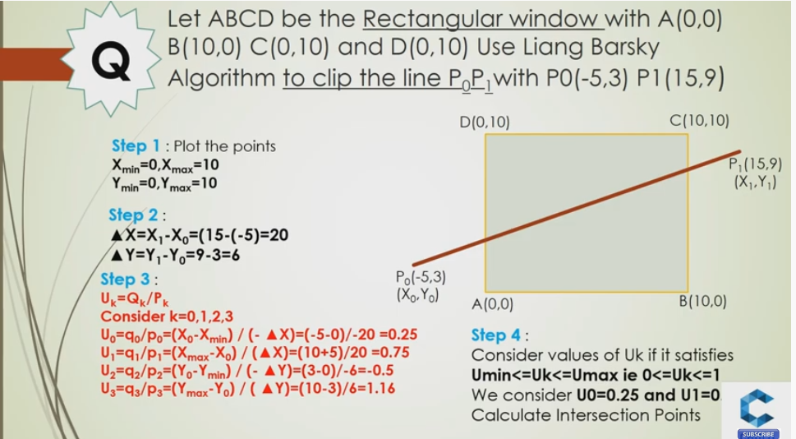
Example

Slide 7
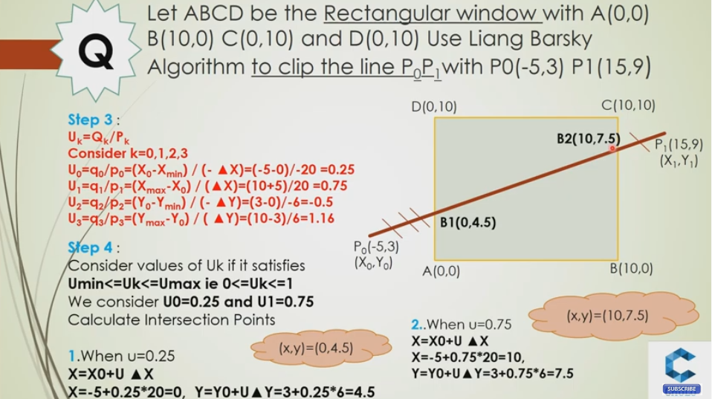
Example

Slide 8
Liang-Barsky
Line Clipping
In most cases, Liang-Barsky is slightly more efficient
  Avoids multiple shortenings of line segments
However, Cohen-Sutherland is much easier to understand
  An important issue if you’re actually implementing

Slide 9
Nicholl-Lee-Nicholl
Line Clipping
This is a theoretically optimal clipping algorithm (at least in 2D)
  However, it only works well in 2D
More complicated than the others
Just do an overview here

Slide 10
Nicholl-Lee-Nicholl Line Clipping
Partition the region based on the first point (p1):
  Case 1: p1 inside region
  Case 2: p1 across edge
  Case 3: p1 across corner
Case 1
T
p1
L
R
B
p1
Case 2
LT
T
L
Case 3
T
TR
p1
L
LR
L
L
LB
TB
LB

Slide 11
Nicholl-Lee-Nicholl
Line Clipping
Can use symmetry to handle all other cases
“Algorithm” (really just a sketch):
  Find slopes of the line and the 4 region bounding lines
  Determine what region p2 is in
    If not in a labeled region, discard
    If in a labeled region, clip against the indicated sides

Slide 12
A Note on Redundancy
Why am I presenting multiple forms of clipping?
  Why do you learn multiple sorts?
    Fastest can be harder to understand / implement
    Best for the general case may not be for the specific case
      Bubble sort is really great on mostly sorted lists
    “History repeats itself”
      You may need to use a similar algorithm for something else; grab the closest match

Slide 13
Polygon Clipping
Polygons are just composed of lines. Why do we need to treat them differently?
  Need to keep track of what is inside
NOTE:
Lines
Polygons

Slide 14
Weiler-Atherton Polygon Clipping
When using Sutherland-Hodgeman, concavities can end up linked
A different clipping algorithm, the Weiler-Atherton algorithm, creates separate polygons
Remember
this?

Slide 15
Weiler-Atherton Polygon Clipping
Example:
Out -> In
Add clip vertex
Add end vertex
In -> Out
Add clip vertex
Cache old direction
Follow clip edge until
(a) new crossing found
(b) reach vertex already
added
In -> In
Add end vertex

Slide 16
Weiler-Atherton Polygon Clipping
Example (cont’d):
Continue from
cached vertex and
direction
Out -> In
Add clip vertex
Add end vertex
In -> Out
Add clip vertex
Cache old direction
Follow clip edge until
(a) new crossing found
(b) reach vertex already
added

Slide 17
Weiler-Atherton Polygon Clipping
Example (cont’d):
Final Result:
2 unconnected
polygons
Continue from
cached vertex and
direction
Nothing added
Finished

Slide 18
Weiler-Atherton Polygon Clipping
Difficulties:
  What if the polygon recrosses
  an edge?
  How big should your cache be?
  Geometry step must be able to create new polygons
    Not 1 in, 1 out

Slide 19
Done with Clipping
Point Clipping (really just culling)
  Easy, just do inequalities
Line Clipping
  Cohen-Sutherland
  Liang-Barsky
  Nicholl-Lee-Nicholl
Polygon Clipping
  Sutherland-Hodgeman
  Weiler-Atherton
Any Questions?

